Slide 1

Structure of DOS application programs

Slide 2
Contents:
1. PSP
2. .COM and .EXE
3. TSR: Terminate and Stay
Resident Programs

Slide 3
About DOS…
Remember the new versions of Windows like XP does not actually contain DOS.
Till Windows 98, it allowed us to boot from DOS mode.
What we have is just the command prompt which is a partial emulation of it.

Slide 4
Type and copy commands
Command types are:
  Internal (internsic) : type ,copy, del
  Carried out by code embedded in Command.Com
  External (extrensic): chkdsk, backup
  Stored in disk files.
  Need to be loaded in transient program area.
  After completions of its work is discarded from the memory.
  Batch files: Contain intrensic, extrensic and batch commands.
  Processed by special interpreter that is in the transient portion of command.com.

Slide 5
When you type anything on command prompt, what happens??
Command.Com checks if it is internal command that can be executed directly.
If not, search for external command, batch file with same name.
  Search from current directory to each of the directories in most recent path.
  In each directory, it tries to find a file with extension .COM or .EXE or .BAT.
  If search fail, it gives bad command or filename.

Slide 6
When you type anything on command prompt, what happens?? (ctd…)
If .Com or .EXE is found:-
  Command.Com uses DOS Exec function to load and execute it.
  It is the EXEC function that builds Program Segment Prefix above the resident portion of Command.com in transient program area.
  EXEC function loads the program just above the PSP.

Slide 7
What is PSP??
Program Segment Prefix is 256 bytes long.
A data structure used in DOS to store the state of the program.
It is set up by MS-DOS at the base of the memory block allocated to a transient program.
Contains various linkages and pointers needed by the application program.
We are going to use this to execute our simulation of type and copy

Slide 8
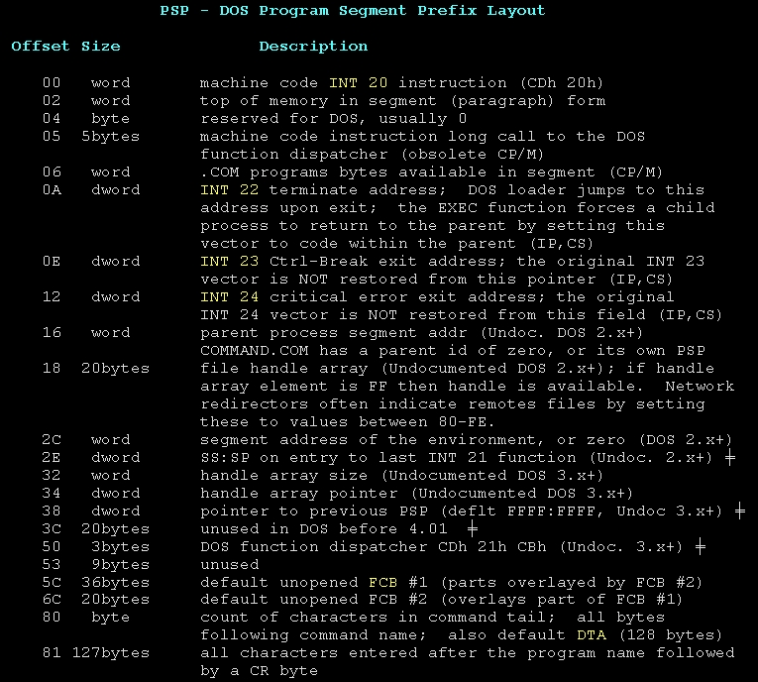
What is PSP??
Program Segment Prefix is 256 bytes long.
A data structure used in DOS to store the state of the program.
It is set up by MS-DOS at the base of the memory block allocated to a transient program.
Contains various linkages and pointers needed by the application program.
We are going to use this to execute our simulation of type and copy

Slide 9
What can I do with PSP??
We can write a program to simulate type command.
Type command types the contents of a file.
At command prompt if I write
c:\type first.asm
It will display the contents of the file.
Similarly we can write our program where instead of type it would be say
c:\mytype first.asm
Using PSP…

Slide 10
Using PSP
With 80h and 81h offset of PSP, we will read the file names.
80h will give us the length of the command string
81h all the characters entered after the no. of arguments.
This is as good as command line arguments in C.
How to get the address of PSP?
  Int 21h function 62h

Slide 11
Which interrupts do I use??
Int 21h, function 3c,3d,3E,3f,4041…
These will be used for creating, opeting , closing files and so on..
Using them we will perform the file operations.

Slide 12
Programs that run under DOS are in two flavours:
    -COM
    - EXE

Slide 13
Comparison between .COM and .EXE Files
Parameters | .COM File | .EXE File
Location | On disk files which hold an absolute image of the machine instructions to be executed | On disk in a special type of file
Segments | stack and data and code segment are in one segment | Multiple code, data and stack segments.
Program size | 64kbytes | As large as the available memory
Initialization | CS Starts at 100h | It is not fixed
Size of file | Exact same as the program | Program size + size of header
Subroutine calls | NEAR | NEAR and FAR
Loading time | Compact and faster | Header, relocation table and other information used by DOS Along with code, so loading time more
Header | No | Yes(For relocation process)

Slide 14
Type of programs
Transient programs
  .EXE
  .COM
TSR programs
  .COM

Slide 15
TSR Programs
Can be loaded after DOS is loaded,
Stay in the memory, even if they are not active on your screen,
They appear to exit, but remain in the memory to perform tasks in the background,

Slide 16
Structure of TSR
Divided into three sections:
  Data area
  Resident routine and
  Initialisation routine

Slide 17
Data Area
Where different data definitions are included as per the requirement of program
e.g. Original entry in interrupt vector table, temporary space for registers etc.

Slide 18
Resident Routine
Portion of program which will be made resident in the memory to perform specified task.
During execution of specified task original register contents may get change so these contents must be preserved and again loaded before calling original interrupt service routine

Slide 19
Initialisation Routine
Does the preliminary work to make resident routine stay resident in the memory,
It executes only once,
It performs following steps
  1) Get the original address of specified interrupt from IVT and save it
  2) Store the address of resident program in the IVT in place of original address,
  3) Calculate the size of the resident routine including Data area and PSP. Reserve the memory area of this size and make the program resident

Slide 20
Initialisation Routine Continued . . .
To perform these three steps we use three INT 21H functions
  Function 35H: Get Interrupt Address
    Call with AH=35H, AL= int #
    Returns vector address in ES:BX
  Function 25H: Set Interrupt Address
    Call with AH=25H, AL=int # , DS:DX= Segment:Offset of interrupt handling routine
  Function 31H: Make program resident
    Call with AH=31h, AL=Return code, DX: amount of memory to reserve.

Slide 21
Examples
Examples:
  Beep system speaker on Key Press.
  Display Real Time Clock
  Screen Saver

Slide 22
